Slide 1
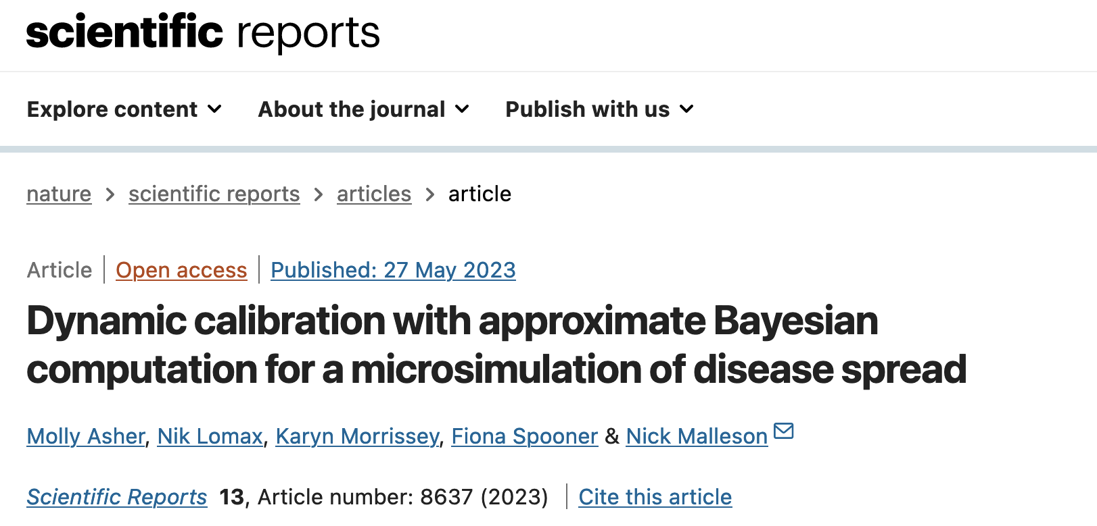

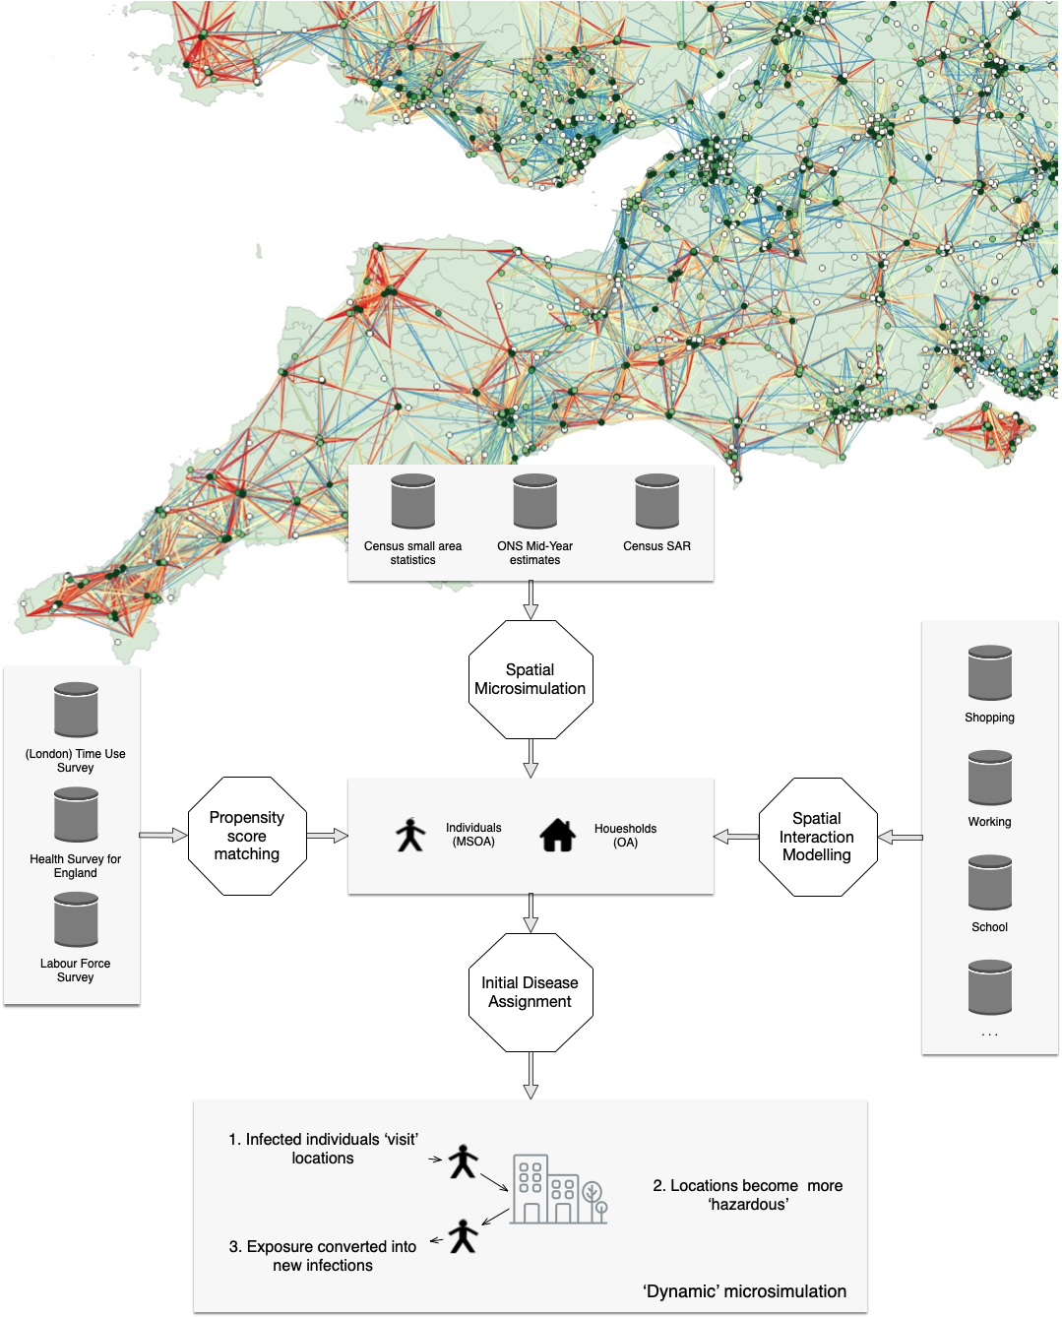
Real-Time Forecasting of Uncertain ABMs with Approximate Bayesian Computation
Molly Asher, Nik Lomax, Karyn Morrissey, Fiona Spooner & Nick Malleson
Asher, M., Lomax, N., Morrissey, K. et al. Dynamic calibration with approximate Bayesian computation for a microsimulation of disease spread. Sci Rep 13, 8637 (2023). https://doi.org/10.1038/s41598-023-35580-z
Notes:
Despite their widespread use in Urban Analytics research, it can be difficult to quantify the uncertainty in the forecasts made by agent-based and other individual-level modelling methodologies. This is particularly problematic if models are used in policy as proper understanding and communication of their uncertainties is crucial. This paper describes the use of Approximate Bayesian Computation (ABC) as a means of exploring the uncertainty in the optimal parameter values of an individual-level model of COVID spread. It also demonstrates the use of the method to iteratively reduce model uncertainties in near real-time as new data become available.

Slide 2
